Slide 1


What’s New in SQL Server 2019?

Slide 2
The Business Case for SQL Server 2019

Slide 3
Audience
This version of the presentation is for IT decision makers, management, C-level
This is part of a larger presentation on all the new things in SQL 2019, including:
New syntax
New maintenance feature
New machine learning features, and more

Slide 4
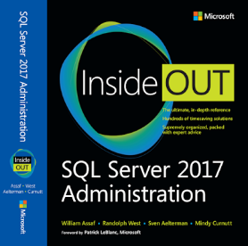
Favorite New Features
http://www.sqltact.com/2017/12/our-sql-server-2017-administration.html 4. What's your favorite new feature of SQL Server 2017? William Assaf: WSFC-less Availability Groups. So many uses, so much easier. With automatic seeding, AG's are close to point-and-click. Randolph West: Linux support. Adaptive query processing. Linux support. Sven Aelterman: Without a doubt, the fact that Reporting Services is a separate download. Everyone loves an additional installer. Mindy Curnutt: Resumable online index rebuilds!! How many times could I have used this. I wonder if Ola's updated his scripts yet to take this into consideration? Louis Davidson: I am into database coding/designing mostly, so graph tables are highest for sure. They are pretty rudimentary now, but the future is very bright in what they are adding in a future version.

Slide 5
SQL Server Version Velocity
SQL 2005 RTM- Nov 7 2005
SQL 2008 RTM- Aug 7 2008 – 33 months later
SQL 2008R2 RTM- April 21 2010 – 20 months later
SQL 2012 RTM- March 6 2012 – 23 months later
SQL 2014 RTM- April 1 2014 – 25 months later
SQL 2016 RTM- June 1 2016 – 26 months later
SQL 2017 RTM- Oct 2 2017 – 16 months later
SQL 2019 RTM- Nov 4 2019 – 25 months later

Slide 6
SQL Server Version Velocity
Starting with SQL 2017, no more service packs, CU’s only.
Stated goal of one CU per month at least for one year.
Within 12 months, 12 CU’s for SQL 2017.
17 CU’s in first 24 months
First public preview of SQL 2019 was only 11 months after SQL 2017 RTM

Slide 7
SQL Server is ready to Upgrade
Thanks for compatibility levels inside each database, the only valid reasons to delay a SQL Server upgrade these days are vendor support
Changes are additive – rarely code breaking
Changes to execution plans in SQL 2014 were 90/10
Easier to upgrade past SQL 2014 from <2014 because of the Query Store introduced in SQL 2016

Slide 8
Tools to Assist with Upgrades
Database Migration Assistant (DMA) – can perform migration to Azure SQL DB for you
Database Experimentation Assistant (DEA) – AB testing for performance on two platforms
Query Tuning Assistant (QTA) – AB testing for performance on two compat levels, same hardware
Will help with the 2014 Cardinality Estimator change

Slide 9
SQL Version Upgrade Timeline
SQL 2008/R2 are past end of life!
No longer supported unless you:
Pay lots of money to Microsoft. Srsly.
Migrate your SQL 2008/R2 SQL Server to an Azure VM. Considerably less money.
SQL Server 2012 SP4 End of Support is July 12 2022.
SQL Server 2012 <SP4 no longer supported!
SQL Server 2014 SP3 End of Support is July 9 2024.

Slide 10
Summary of Changes in SQL 2019
v1.0 of Big Data Clusters
TDE now Standard Edition!
Accelerated Database Recovery (ADR)
New features in “Intelligent Query Processing” umbrella: Major performance boosts: Scalar UDF in-lining (automatic!), TempDB metadata in memory, Accelerated Database Recovery (ADR), OPTIMIZE_FOR_SEQUENTIAL_KEY, more!
Quality of Life improvement: specific string truncation error
More little things

Slide 11
IT Leadership: Need to Know Changes

Slide 12
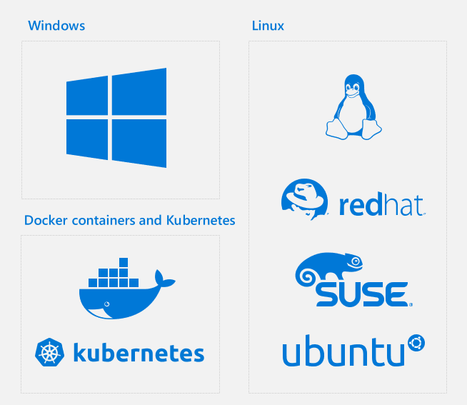
No Longer Just Windows
https://cloudblogs.microsoft.com/sqlserver/2018/09/26/sql-server-2019-celebrating-25-years-of-sql-server-database-engine-and-the-path-forward/

Slide 13
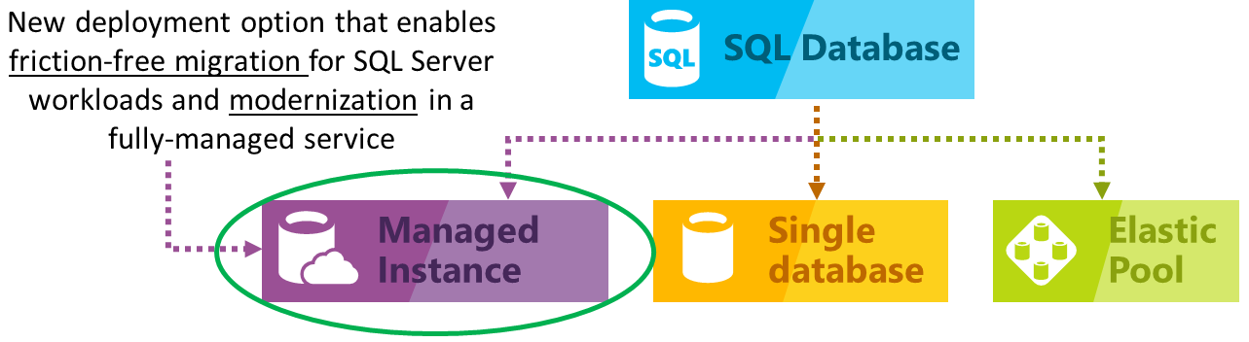
No Longer Just Windows
Coming soon with Azure Arc: Run Azure SQL Database on-prem!
Azure Arc: hybrid cloud+on-prem management for Azure
https://azure.microsoft.com/en-us/blog/migrate-your-databases-to-a-fully-managed-service-with-azure-sql-database-managed-instance/

Slide 14

SQL Server on Linux
Red Hat Enterprise (RHEL) preferred, also Ubuntu, SUSE Linux Enterprise
Support for integrated Active Directory auth
Linux cluster managers like Pacemaker can be used
Almost fully-featured SQL Server on Linux
New in SQL 2019: Support for replication, MSDTC, CDC

Slide 15
SQL on Linux
SQL Server “mssql-server” installs on Linux, but SSMS won’t.
Options for tooling on Linux:
Install SSMS on Windows, manage SQL on Linux remotely
“mssql-tools” installs command-line tools Sqlcmd, bcp, drivers and more on Linux
Azure Data Studio – cross-platform SQL management software that is, based Visual Studio Code
Third party software

Slide 16
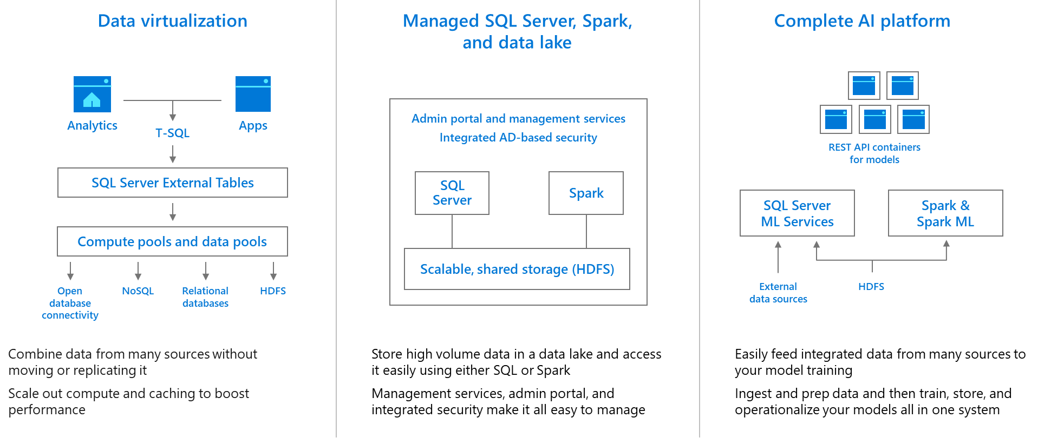
Big Data Clusters: SQL Server, Spark, and HDFS in Kubernetes
The entire data lake within SQL Server 2019 product
https://cloudblogs.microsoft.com/sqlserver/2018/09/24/sql-server-2019-preview-combines-sql-server-and-apache-spark-to-create-a-unified-data-platform/

Slide 17
Big Data Clusters: SQL Server, Spark, and HDFS in Kubernetes
Big Data Clusters (BDC) is the entire data lake within SQL Server
All data, both relational and non-relational, queryable with TSQL
Minimizes data movement, sprawl of skillsets/languages
Built on Kubernetes, requires some knowledge there to config
No data movement + scale = no ETL, schema/analysis on read

Slide 18
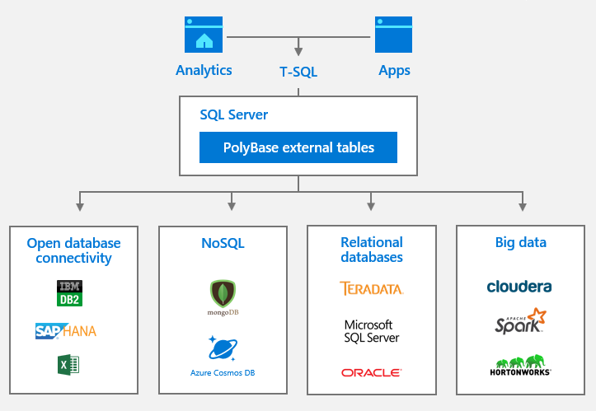
PolyBase Query Service For External Data
Query external, non-Microsoft, non-relational with PolyBase External Tables aka “Data Virtualization”
That’s right, query Oracle with T-SQL
https://cloudblogs.microsoft.com/sqlserver/2018/09/25/introducing-microsoft-sql-server-2019-big-data-clusters/

Slide 19
PolyBase Query Service For External Data
The PolyBase Query Engine makes it possible to query Hadoop nonrelational data or Azure Blob Storage files using T-SQL, by creating EXTERNAL tables in SQL Server connected directly on Azure Storage, Oracle, Teradata, Hadoop, MongoDB, much more

Slide 20
PolyBase Query Service For External Data
Superior alternative to Linked Servers, OPENDATASOURCE, or heterogenous replication:
External tables allows for clear schema
More secure – inside a database, not at instance level
ODBC drivers offer scale-out options
Optimized for large analytic-scale queries
Offers “Push Down” computation for external sources, significantly reducing data transferred
But does require additional setup.

Slide 21
Machine Learning Services
2016- “R Services” supported R
2017- Now “Machine Learning Services”, supports R + Python
2019- New features added, including support for external libraries, SQL Server on Linux, clustered service support
You can install R and/or Python depending on requirements.
What’s more, you can install these ML services directly in the Database Engine (in-database as a service called LaunchPad)
or as standalone components without a SQL Server.

Slide 22
Feature/Edition improvements
Transparent Data Encryption (TDE) is now supported in standard edition in SQL 2019!
As well as the Extensible Key Management feature that allows 3rd party (Hardware Security Module) HSM vendors including the Azure Key Vault (AKV)
All hardware caps/limits are the same since SQL 2016

Slide 23
Graph Tables
New to SQL 2017, improving in SQL 2019
Competing with Neo4j or Gremlin (also the CosmosDB Gremlin API)
Graph data is often associated with networks, such as social networks. Graphs data structures consist of nodes and edges.
Nodes are also referred to as vertices, and edges as relationships.
More graph-specific syntax in SQL 2019, integration with Merge syntax
For highly interconnected data with many many-to-many relationships (think IMDB)
Hierarchical data can be served with a special hierarchyid data type

Slide 24
State of the Columnstore
Columnstore indexes aren’t new, around since SQL 2012.
Not a B+tree; compressed columnar data (disk and memory).
You can create “nonclustered” or “clustered” Columnstore indexes, though these are in name only.
Can only have one Columnstore index per table.

Slide 25
State of the Columnstore
Writeable as of SQL 2016. Prior, columnstore indexes read-only.
This finally unleashed columnstore indexes for use in OLTP.
Starting with SQL 2016, add a Columnstore index to in-memory tables for “real-time analytics” on rapidly-inserted data
With SQL Server 2016 SP1, Columnstore indexes are available below Enterprise edition (with memory limits)
Starting with SQL 2016, you can now filter the Columnstore index just like a nonclustered index.

Slide 26
State of the Columnstore
Batch Mode Execution now supported in some rowstore index operations in SQL 2019.
Also new in SQL 2019:
New COLUMNSTORE_ARCHIVE compression level for even more space savings.
Improved internals for memory management.
Improved performance of bulk loading to columnstore.

Slide 27
Azure SSIS Lift-and-Shift with Azure IR
With minimal/no code changes, run SSIS packages in Azure Integrated Runtime (IR) instead of a SQL instance.
More info: https://docs.microsoft.com/en-us/azure/data-factory/tutorial-deploy-ssis-packages-azure
Side note: Data Factory v1 was just really terrible, replaced by v2 (better), but you can do cloud-run SSIS with the Integration Runtime as well.

Slide 28
New Installer Smart Defaults
TempDB (SQL 2017)
Max Server Memory (SQL 2019)
MAXDOP (SQL 2019)
All intelligently defaulted in the SQL Setup, allowing for smarter “Just Click Next” installs

Slide 29
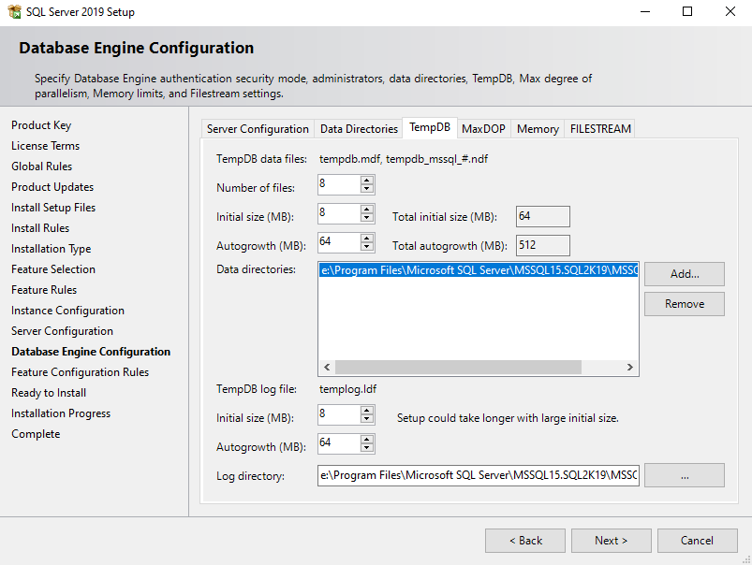
New Installer Smart Defaults

Slide 30
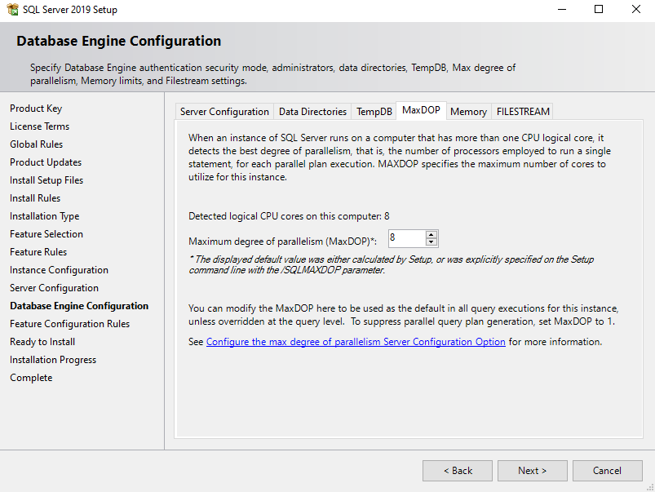
New Installer Smart Defaults

Slide 31
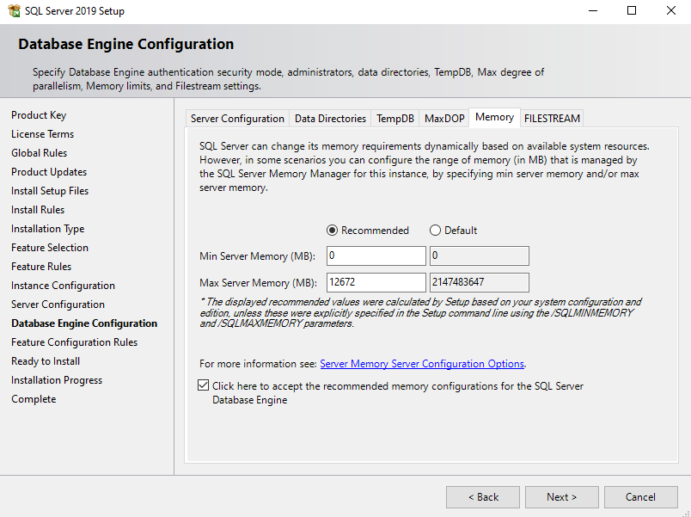
New Installer Smart Defaults

Slide 32
Availability Groups
New in SQL Server 2019, Always On Availability Groups have been enhanced to include automatic redirection of connections to the primary based on read/write intent.
Feature: “Automatic read write connection re-routing”
Further closes the cap created upon failover, read/write connections to secondary are automatically sent to primary.
Connect to any replica, get sent to Primary. Cool!

Slide 33
Availability Groups
New in SQL Server 2019: Up to 5 synchronous replicas
Software Assurance –Azure VM SQL licensing in your Availability groups are now FREE
Availability Groups now supported in Kubernetes
Not supported in SQL for Windows on Docker (yet)

Slide 34
Hybrid Buffer Pool
SQL Server 2019 can take advantage of Persistent Memory Devices (PMEM) (non-volatile RAM).
Example: Intel Optane DC persistent memory
Can be used by Win Server 2019 with Storage Spaces Direct.
Moves clean buffer pool pages out of RAM and onto PMEM
Dirty pages still stored in DRAM
Can be disabled at the database level, allowing only the most performance critical databases to take advantage.
Supported in both Windows and Linux
Enterprise and Standard edition

Slide 35
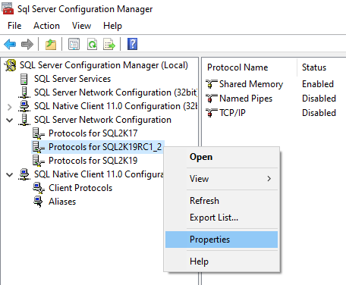
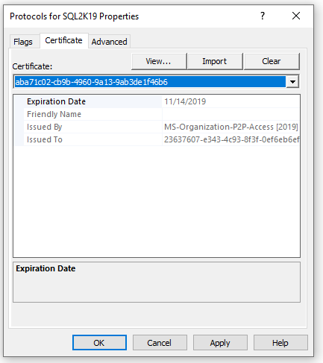
Certificate Management inside Configuration Manager
New in SQL Server 2019: Manage and monitor SSL/TLS certificates
Deploy certs to instances in a AG or FCI easily

Slide 36
UTF-8
Store UTF-8 data in char/varchar, replacing(?) nchar/nvarchar
UTF-8 is the most popular character encoding set for XML, HTML, and the World Wide Web.
90%+ of the web is encoded UTF-8, all languages have most of their characters represented in a single data page of UTF-8.
Nchar/Nvarchar are UTF-16: better coverage, 2x the space.
Choosing a UTF-8 collation allows for a wider variety of character values inside the char/varchar data types, at half of the storage compared to UTF-16.

Slide 37
UTF-8
String data is encoded UTF-8 when using a collation with suffix like: LATIN1_GENERAL_100_CI_AS_SC_UTF8
Set at the instance-level or database-level
For mostly Latin characters, should be more efficient than UTF-16 (nchar/nvarchar), reducing storage by 50%.
Unless you need to store characters outside of UTF-8, consider nvarchar no longer useful!
Supported in all editions

Slide 38
Major TempDB improvements
“Memory-optimized tempdb metadata” improves writes to TempDB as internals are rapidly written.
Eliminates lock/latch waits observed in databaseid = 2
Typically a problem in workloads with large numbers of concurrent users and/or excessive TempDB usage
Enterprise only feature for now.

Slide 39
New TSQL Syntax in SQL 2019
OPTIMIZE_FOR_SEQUENTIAL_KEY
Reduces PAGELATCH_EX waits on “hot spots” where rapid inserts occur on the last page
Improves performance up to 30%
Add to the definition of each index
A sequential key was always superior to a random key, now it’s even faster
toolbox\lab - optimize_for_sequential_key testing.sql
https://techcommunity.microsoft.com/t5/SQL-Server/Behind-the-Scenes-on-OPTIMIZE-FOR-SEQUENTIAL-KEY/ba-p/806888

Slide 40
New TSQL Syntax in SQL 2019
APPROX_COUNT_DISTINCT function
Reduces the amount of reads in very large table scans. Could save a lot of reads in millions+ rowcounts
Useful in mass estimation of distinct values, but not exact
Important in determining the
Unless you have millions+ rows, won't be much of a help, and can in fact take slightly MORE reads, to return less accurate data.
SELECT APPROX_COUNT_DISTINCT(id) from table --vs SELECT COUNT(DISTINCT id) from table

Slide 41
Accelerated Database Recovery
New in SQL Server 2019
Instant rollback of long-running transactions or maint operations
Instant recovery for databases at startup
Can truncate the transaction log around long running transactions, reducing log file size.

Slide 42
Accelerated Database Recovery
Works via a persistent Version Store stored directly in the User database, may increase .mdf size by 10%+.
NOT enabled by default
ALTER DATABASE whatever SET ACCELERATED_DATABASE_RECOVERY = ON;
Otherwise, it is downright magical.
Supported in Enterprise AND Standard edition.

Slide 43
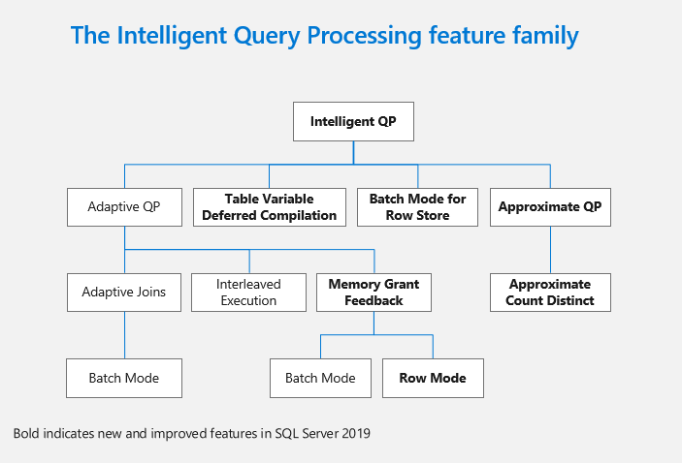
New Intelligent Query Processing features
https://cloudblogs.microsoft.com/sqlserver/2018/09/26/sql-server-2019-celebrating-25-years-of-sql-server-database-engine-and-the-path-forward/

Slide 44
Performance Boost: Batch mode on rowstore
Batch mode operators work more efficiently for large rowcounts, a major scalability improvement
Prior to compat 150, only possible on columnstores.
With compat 150, batch mode is another tool for the query optimizer for use on heaps and B-tree indexes.

Slide 45
Performance Boost: Batch mode on rowstore
New BATCH_MODE_ON_ROWSTORE database scoped configuration
On by default in compat 150
“This batch mode scan can evaluate batch mode bitmap filters. You might also see other batch mode operators in the plan. Examples are hash joins, hash-based aggregates, sorts, window aggregates, filters, concatenation, and compute scalar operators.”
https://docs.microsoft.com/en-us/sql/relational-databases/performance/intelligent-query-processing?view=sql-server-ver15#batch-mode-on-rowstore

Slide 46
Performance Boost: Memory Grant Feedback
Already had Memory Grant Feedback for batch mode.
Now supported for row mode.
More efficient memory estimation and handling
Prevents spill to disk if memory initially underestimated
Enterprise edition feature only in SQL 2019 for both row and batch mode.

Slide 47
Performance Boost: Scalar UDF in-lining
Developers now off the hook for some bad habits.
Will immediately, dramatically improve performance where Scalar UDF’s are abused. Doesn’t help TVF’s.
Prevents UDF's in the SELECT or ON part of queries from exploding query cost with RBAR.
On by default with Compatibility Level 150 (SQL 2019), in all editions.
Another feature introduced in SQL 2017, Interleaved Execution can help with TVF’s.

Slide 48
Performance Boost: Table variable deferred compilation
Improves plan quality, overall performance of table variables
Table variables still lack column statistics – a key difference.
On by default with compat level 150.
https://blogs.msdn.microsoft.com/sqlserverstorageengine/2018/07/16/public-preview-of-table-variable-deferred-compilation-in-azure-sql-database/

Slide 49
Performance Boost: Table variable deferred compilation
Existing behavior: Table variables are compiled along with all other statements, cannot know the actual row count at time of execution, so a fixed guess of one row is used.
This is why table variables are only good for very small rowcounts
Underestimation of rowcount caused poor performance
In SQL 2019: compilation behavior matches that of temp tables, and results in the actual rowcount being used in the plan, much better plans. No change if you’re already using Table vars appropriately.

Slide 50
More Specific string truncation error messages
New in SQL 2019: Better error messages for failed inserts!
After SQL 2017 CU12, can be enabled with trace flag 460.
Old:
Msg 2628, Level 16, State 1, Line 10
String or binary data would be truncated.
The statement has been terminated.
New: Msg 2628, Level 16, State 1, Line 37
String or binary data would be truncated in table 'tempdb.dbo.string_truncation_test', column 'chars'.
Truncated value: 'aaaaaaaaaaaaaaaaaaaaaaaaaaaaaaaaaaaaaaaaaaaaaaaaaaaaaaaaaaaaaaaaaaaaaaaaaaaaaaaaaaaaaaaaaaaaaaaaaaaa'.
The statement has been terminated.
Lab - toolbox\lab - string truncation error message improvement in SQL 2019.sql

Slide 51
New Data Classification Schema
Before SQL 2019, Data Classification feature used database extended properties to store this data.
Now, a dedicated schema for this data.
Designed to aid auditing, GDPR, and compliance.
Available in all editions.

Slide 52
SQL Assessment API
New programmatic interface for Health Checks
Can access with .NET, PowerShell, etc.
Part of the new SMO, actually delivered with the latest editions of SSMS.
Available in all editions.

Slide 53



HEALTH CHECK
REMEDIATION
MANAGED SQL
The Sparkhound SQL DBA Team
Knowledge Transfer – We work with your Devs, DBA’s, “accidental” DBA’s.
Pros Nearby – Sparkhound’s DBA team of FTE’s are US-based, CT zone.
Microsoft & Peer Recognized – Sparkhound DBA team is 100% Microsoft certified, and members have spoken at conferences and user groups.
Proven Success – For years we have supported servers in US and Europe.
Dev Background – Experience as former developers provides context.
The Checklist - Reference for future checks, audit prep, new SQL builds.

Slide 54
Sparkhound Managed SQL
HEALTH CHECK
REMEDIATION
MANAGED SQL
Interactive Health Check
Windows, SQL, Process
Remediation
Planning
Proactive Health Checks
Reactive Alerting
Regular Maintenance Windows
Knowledge Transfer
Special Project Assistance
Documentation/Process Improvement
Trending/Analysis
Checklist
Critical
High
Medium
Low
Checklist
Maintenance
Window
Managed Services
Emphasis on Knowledge Transfer
What, Why, How

Slide 55
Sparkhound SQL DBA Consulting Services
Performance Tuning, with App Services team
Reporting, with our Data Analytics team
Upgrades/Migrations/Data Conversions
High Availability/Disaster Recovery solutions
Pre-audit, encryption, database security
Maintenance/administration
Automation/PowerShell
Azure SQL (IaaS or PaaS) architecture
Training/Knowledge Transfer/skillset updates

Slide 56

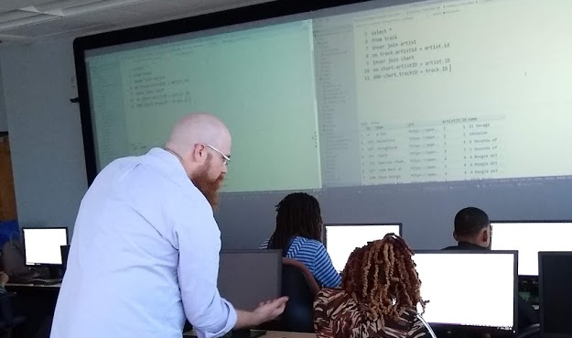
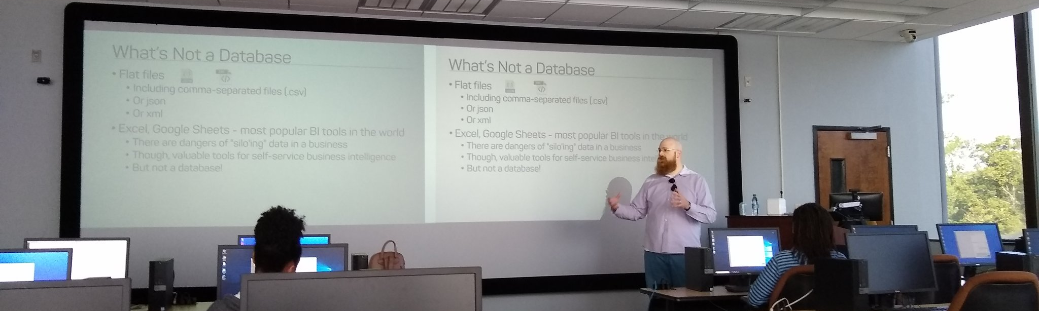
Support your Local STEM Initiatives
I encourage you to find, then donate time and money to local STEM education initiatives where you live. Get involved!
There is almost certainly some nonprofit where you live that needs your enthusiasm and skills to close the achievement gap.
https://www.thewallsproject.org/programs/futures_fund/

Slide 57
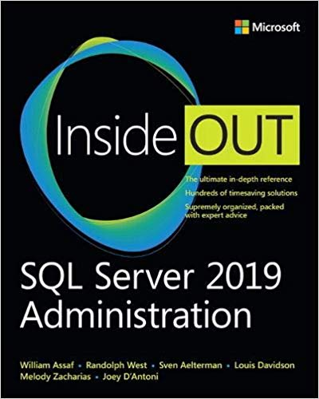
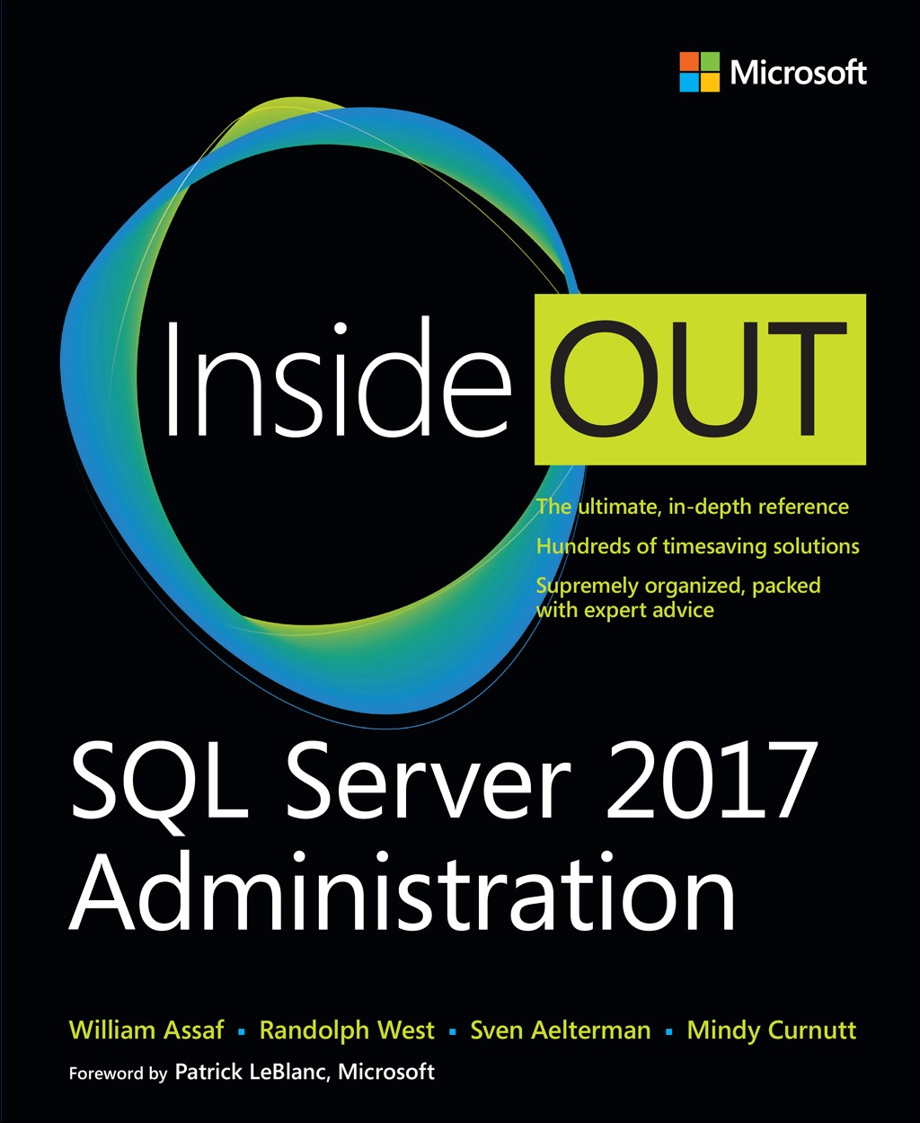
SQL Server 2017 Inside Out
SQL Server 2019 Administration Inside Out
by Microsoft Press
2017 published Feb 2018
2019 coming Dec 2019

Slide 58

Bio and contact
William D Assaf, MCSE
Baton Rouge SQL Server UG board
Principal Consultant, SQL Manager at Sparkhound
William.Assaf@sparkhound.com
Twitter: @william_a_dba
This presentation, including all source code, available at my blog:
SQLTact.com

